Slide 1
Training a Neural Net Guided RC Car to Navigate Around Obstacles in a Closed Course
Hari Shanmugaraja and Tony Liang

Slide 2
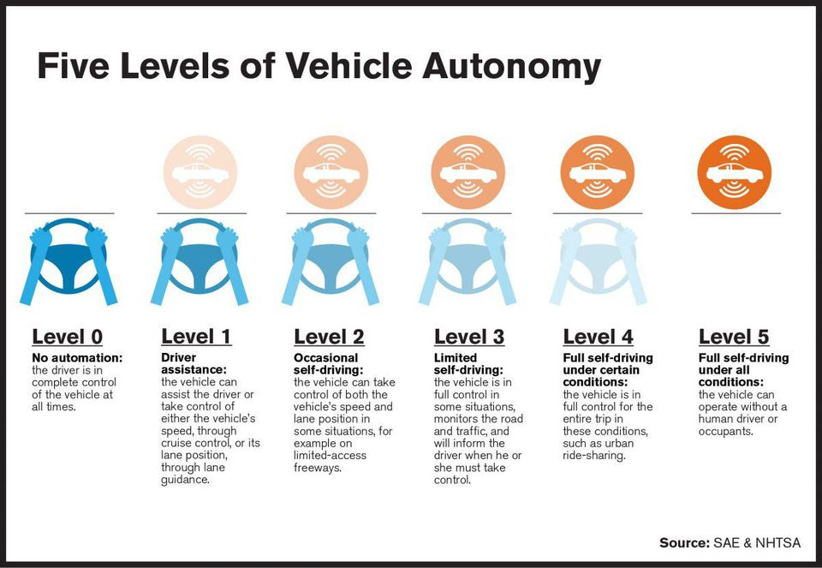
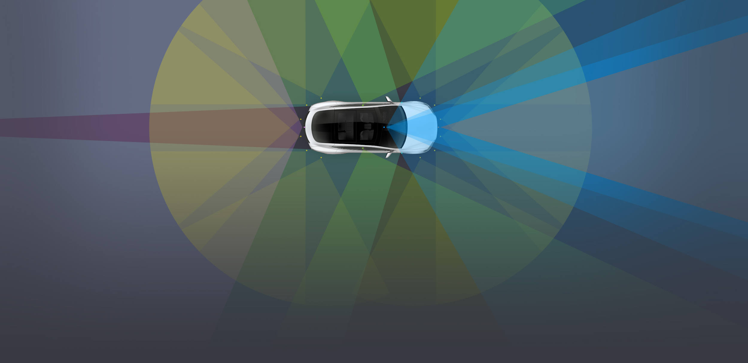
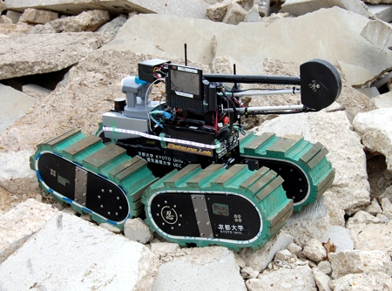
Motivation
Self-driving car technology has come a long way
Improvements are still necessary
Ethics are ambiguous
There is substantially less research done with smaller vehicles

Slide 3
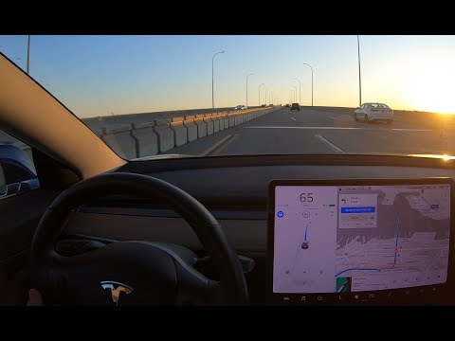
Quick Video
Keep in mind this video was published to YouTube on Nov. 8th 2019 (3 days ago)

Slide 4
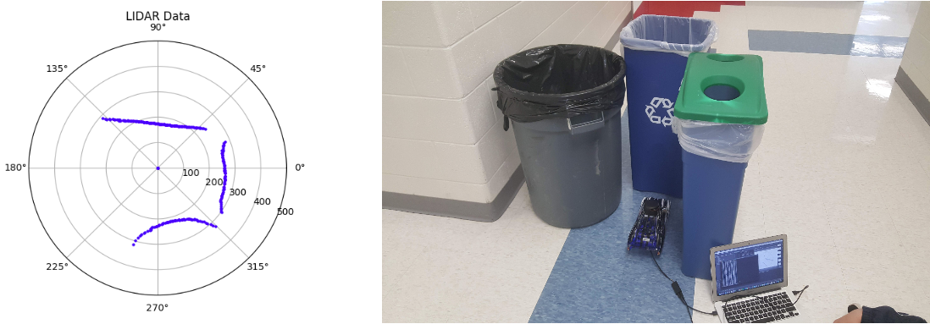
Proposal
We will use LIDAR, cameras, and accelerometers in order to train a recurrent neural network, as they are known for their time series functionality. This project aims to help further and refine research into the autonomous vehicle field by creating a self driving remote-control car that is able to detect and avoid obstacles, all while completing a closed course.

